Slide 1


Network attack detection & defense

Slide 2

Session Outline
Authentication:
Denial of service attacks
Attack mitigation
Tools for this session:
Linux router
VMWare Workstation or VMWare Player

Slide 3

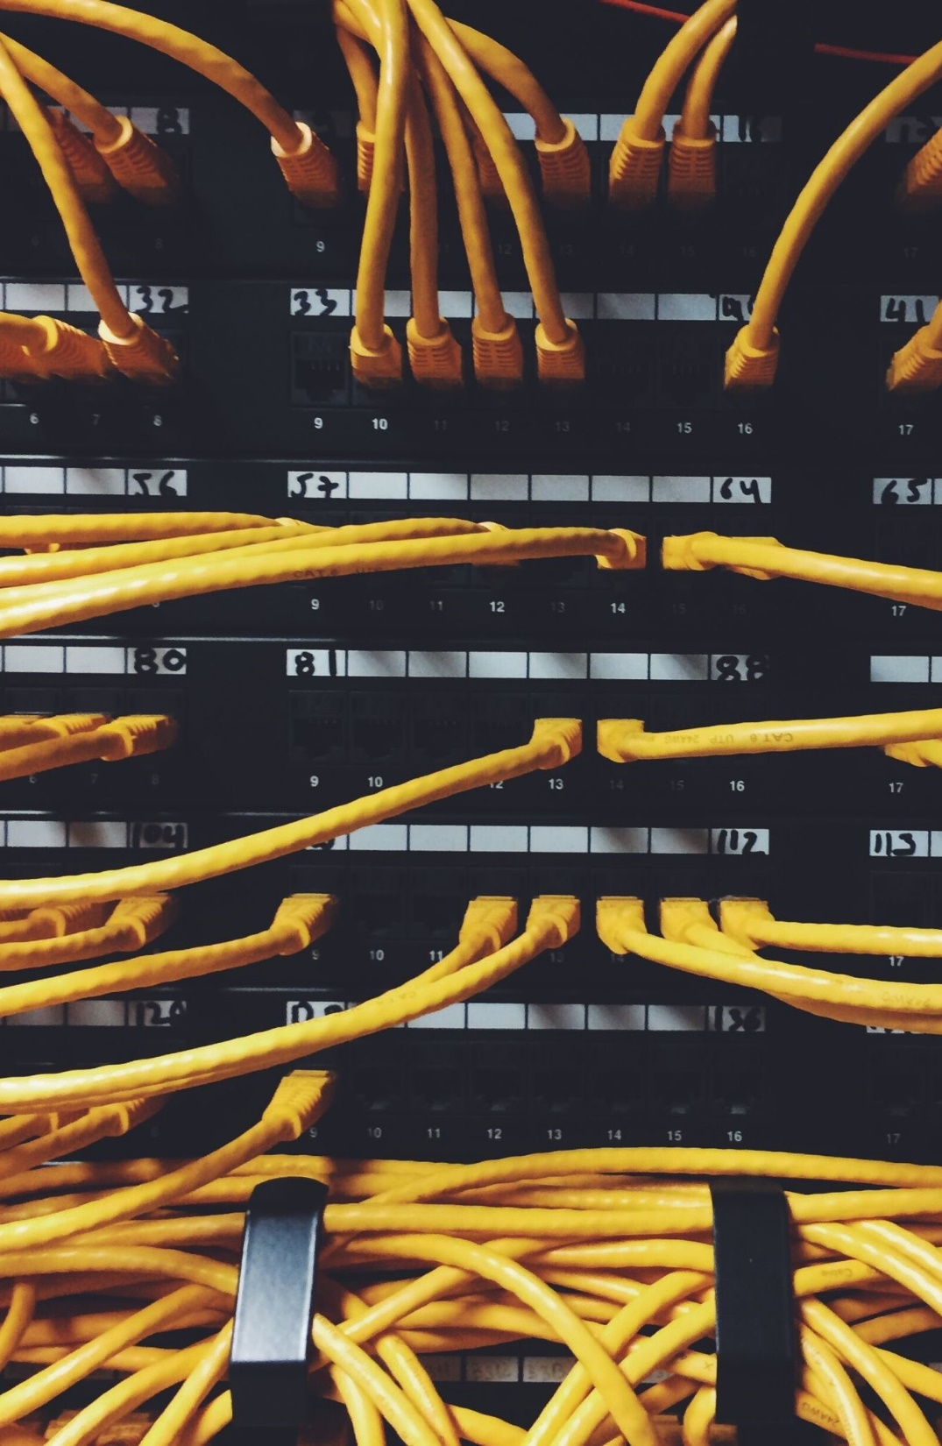
Denial of Service attacks
Mechanisms to deny legitimate users or hosts access to
A service
Network
Internet
Mounted via a range of methods
Block access to network
Block access to Internet
Block access to a web server
Etc

Slide 4

Block access to the network - attack
One example – DHCP
Used by typical hosts to get an IP address and access the network
Based on a DHCP server that leases IP addresses from a pool
Examples of attacks
Rogue DHCP server – server that connects to the network and leases IP addresses in the wrong range
DHCP starvation attack – attacker that uses up all the IP addresses in the DHCP server pool
Detection – clients do not get an IP address or get a “wrong” IP address and cannot connect to the Internet

Slide 5
Block access to the network - mitigation
Rely on switches
Allow DHCP only from recognised ports
Block DHCP traffic from other ports
Allow only a limited number of MAC addresses on each port
Attackers cannot spoof large number of MAC addresses to starve the DHCP server

Slide 6


Web server DoS - attack
Flood the server with traffic/requests until the server cannot reply to genuine requests
A server would have a limited number of “slots” to support clients
If an attacker places more requests than the number of slots, the server cannot accept any further requests and legitimate clients are rejected

Slide 7

Web server DoS - mitigation
Control incoming traffic on the web server
Limit the number of connections from an IP address
This has limited effectiveness
DDoS still possible

Slide 8

Network environment
Physical
Several machines connected with Ethernet cables to a physical switch and then to internet
Virtual
Create several virtual machines and network devices connected in a virtual environment
eve-ng
Used by network designers/engineers to replicate/test large networks without the need of physical devices

Slide 9

Any Questions?
Thank You

